Slide 1
Cryptography
Symmetric cryptography

Slide 2

QQ group

Slide 3
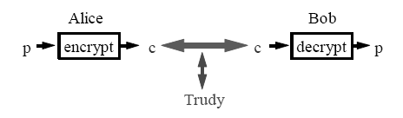
Reference scenario
Alice needs to send a message to Bob
The communication channel is insecure
Active attacks: modification
Passive attacks: eavesdropping
Alice and Bob use a system to secure the communication
Cryptographic system

Slide 4
Problems
Which system to choose?
Cryptographic algorithms, e.g., encryption/decryption
What is the complexity and security?
How to agree on the keys used?
How to ensure security of communication over insecure medium?

Slide 5
Cryptology
Etymologically, the art of secret writing
Cryptology = cryptography + cryptanalyse
Cryptography: secret writing
Study of mathematic techniques to enforce security properties
Confidentiality, integrity, authentication, non-repudiation
Converts data into unintelligible (random-looking) form
Must be reversible (can recover original data)
Cryptanalyse: the art of revealing secret
How to break a cryptographic system
If cryptography is combined with compression:
What to do first?
Notes:
crypt=hidden; graph=write

Slide 6
Cryptography vs. Steganography
Steganography concerns existence
covered writing
hide existence of a message
Cryptography concerns content
hidden writing
hide meaning of a message
Notes:
隐写术，潘兴

Slide 7
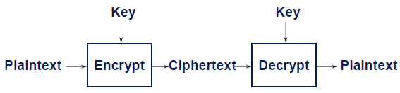
Cryptographic system
Plaintext: original message
Ciphertext: coded message
Cipher: algorithm transforming plaintext to ciphertext
Key: info used in cipher known only to sender/receiver
Encipher/encrypt: plaintext -> ciphertext
Decipher/decrypt: ciphertext -> plaintext

Slide 8
Cryptanalysis
Objective: reveal the plaintext without knowing keys
Difficulty depends on
Security of the encryption/decryption algorithms
Information disposed by the attacker
4 attack models
Ciphertext only
Known plaintext
Chosen plaintext
Chosen ciphertext
Chosen text
Notes:
密码分析：取决于防守方和攻击方

Slide 9
Attack models
Ciphertext only
Attacker knows only ciphertext
Attacker intercepts some ciphertext
Breaking the system by analyzing intercepted ciphertext
Any algorithm vulnerable to this attack is completely insecure
Known plaintext
Attacker has some plaintext and their ciphertext
Chosen plaintext
Attacker can choose arbitrary plaintext to be encrypted and obtain the corresponding ciphertext
Standard security level: resistence to chosen plaintext attack
Chosen ciphertext
Attacker can choose arbitrary ciphertext to be encrypted and obtain the corresponding plaintext
Chosen text: chosen plaintext + chosen ciphertext
Notes:
已知明文攻击：二战破译enigma
选择明文攻击：中途岛

Slide 10
Perfect vs. Computational Security
Perfectly secure cipher
No matter how computer power is powerful, it cannot break the cipher
Ciphertext does not reveal any information about plaintext
Resilience against ciphertext only attack
And
Plaintext does not reveal any information about ciphertext
Resilience against known/chosen plaintext attack
Computationally secure cipher
The cost of breaking the cipher > the value of the encrypted info
And/or
The time required to break the cipher > the useful lifetime of the info
Ad hoc security (heuristic security)
Notes:
完全（无条件），计算安全性

Slide 11
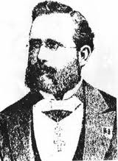
Secret Keys vs. Secret Algorithms
Keep algorithms secret
Secret algorithms -> better security
Hard to keep secret if used widely
Every NATO and Warsaw Pact algorithm during Cold War
All digital cellular encryption
HD DVD, Blu-Ray
Publish algorithms
Security depends on the secrecy of the keys
Public examination helps to find flaws
Kerckhoffs principle
A cryptographic system should be secure even if everything about the system, except the key, is public knowledge.
Reformulated by Claude Shannon as the enemy knows the system
Shannon's maxim

Slide 12
Kerckhoffs
Auguste Kerckhoffs (1835-1903): Dutch-French cryptographer
Jean-Guillaume-Hubert-Victor-François-Alexandre-Auguste Kerckhoffs von Nieuwenhof
Dutch linguist of French nationality, got his Ph.D. in Germany, worked as professor in HEC Paris
Major contribution: a practical, experience-based approach, including six design principles for military ciphers
The system must be practically, if not mathematically, indecipherable.
It must not be required to be secret, and it must be able to fall into the hands of the enemy without inconvenience.
Its key must be communicable and retainable without the help of written notes, and changeable or modifiable at the will of the correspondents.
It must be applicable to telegraphic correspondence.
Apparatus and documents must be portable, and its usage and function must not require the concourse of several people.
It is necessary, given the circumstances that command its application, that the system be easy to use, requiring neither mental strain nor the knowledge of a long series of rules to observe.
Notes:
普法战争法国战败的产物

Slide 13
History of cryptographic systems
First generation: classic ciphers, paper & ink based
Substitution cipher
Mono-alphabetic
Caesar
Poly-alphabetic
Vigenere
Permutation cipher
Second generation: use cryptographic engines
Mechanic and electro-mechanic
Enigma, Hagelin C38
Third generation: modern cryptography
Based on advanced math/TCS
Information-theoretic security
Computational security
Notes:
第一代：文艺复兴；第二代：战争，工业革命后；第三代：信息技术革命

Slide 14
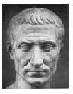
Caesar cipher
Substitution, mono-alphabetic cipher
Plaintext : THIS IS THE CAESAR CIPHER
Ciphertext : WKLV LV WKH FDHVDU FLSKHU
Key: k (=3)
Caesar has never changed the key!
Test: find the plaintext of the ciphertext below
VHFXULWBDQGSULYDFB

Slide 15
Caesar cipher: formalism
P=C=K=Z₂₆
Encription: e_{k}(x) = x+k mod 26
Decryption: and d_{k}(y) = y-k mod 26
x∈P, y∈C, k∈K
Dominates the art of secret writing in the first millennium A.D.
Julius Caesar ~60 BC
Phonetic substitution used in India even earlier
Thought to be unbreakable
Notes:
群：封闭性，结合律，单位元，逆元，阿贝尔群（加法群）

Slide 16
Generalized Caesar cipher
Substitution, mono-alphabetic cipher
Randomly map one letter in plaintext to ciphertext
# combination
26! = 2⁸⁸
Key length: 88 bits
Need to specify which permutation

Slide 17
Generalized Caesar cipher: attack
Vulnerable to known plaintext attack
Ciphertext only
Attacker disposes ciphertext
Technique: frequency analysis

Slide 18
Frequency analysis
Earliest known in a book by the ninth-century scientist al-Kindi
Rediscovered or introduced in Europe during Renaissance
Frequency analysis made substitution cipher insecure
Improvements
Using numbers as ciphertext alphabet, some representing nothing are inserted randomly
Deliberately misspell words
Thys haz thi ifekkt off diztaughting thi ballans off frikwenseas
Homophonic substitution cipher
Each letter replaced by a variety of substitutes
Make frequency analysis more difficult, but not impossible
Mono-alphabetic cipher is still vulnerable to frequency analysis
Notes:
al-kindi阿拉伯伟大哲学家，天才，影响文艺复兴

Slide 19
From mono- to poly-alphabetic cipher
Weaknesses of mono-alphabetic cipher
Each ciphertext letter corresponds to only one plaintext letter
Frequency attack easy to mount
Idea for a stronger cipher
Use more than one cipher alphabet, and switch between them when encrypting different letters
1460’s by Alberti: The Alberti Cipher disk
Plaintext on inner, ciphertext on outer
Rotated to a new position periodically

Slide 20
Leon Battista Alberti
1404-1472, Italian Renaissance humanist author, artist, architect, poet, priest, linguist, philosopher and cryptographer
The Renaissance man
Notes:
左，florence圣母百花教堂，中, venise santa sebasteo教堂未完成，右，florence乌菲兹

Slide 21
Vigenere Cipher
Substitution, poly-alphabetic cipher
Use multiple mono-alphabetic substitution rules
Example: key = (3 1 5)
Replace first letter in plaintext by letter+3, second by 1, third letter by 5
Repeat the above cycle
Notes:
1892 法国政府逮捕保皇党，证据为Vigenere Cipher

Slide 22
Blaise de Vigenère
1523-1596, French diplomat, cryptographer, translator and alchemist
Notes:
47岁退休，之后为巴黎穷人捐出1年收入，亨利4世
vigenere square行key列plaintext
St-etienne du mont

Slide 23
Vigenere Cipher: formalism
Encryption:
e_{k}(p₁, … p_{m}) = (p₁+k₁, …p_{m}+k_{m}) (mod 26)
Decryption:
d_{k}(c₁, … c_{m}) = (c₁-k₁, … c_{m}-k_{m}) (mod 26)
Can be regarded as mutiple Caesar ciphers
But masks frequency
Frenquency analysis more difficult, but still possible
Notes:
1892 法国政府逮捕保皇党，证据为Vigenere Cipher

Slide 24
Vigenere Cipher: cryptanalysis
Find the length of the key m
Divide ciphertext into m Caesar ciphertexts
Method 1: exaustive search
Method 2: Kasiski test
First described in 1863 by Friedrich Kasiski
Frequency analysis made substitution cipher insecure

Slide 25
Permutation cipher
1D permutation
Permute each 5-letter block in plaintext according <+1,+3,-2,0,-2>
2D permutation
Arrange plaintext in n*m blocks
Permute columns in a block according to key

Slide 26
Permutation example: Scytale
First mentioned by a poet in Greece, 7th century BC
Key: diameter of Scytale

Slide 27
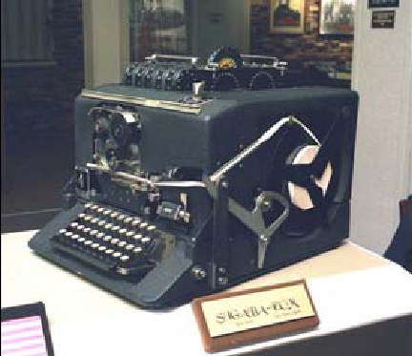
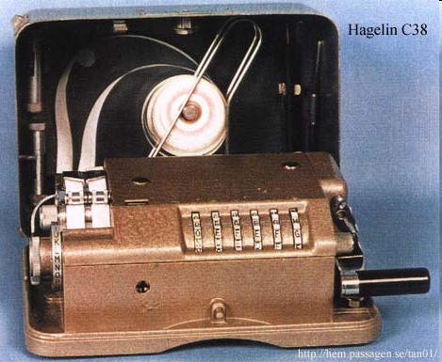
2G: (electro-)mechanic cipher
Notes:
工业革命，战争

Slide 28
Enigma
Widely used in Germany during WWII
Rotor machine: enhanced Vigenère cipher
Rotor machine:
Multiple rotating cylinders (rotors)
Each rotor implements a substitution cipher
Output of each rotor is fed into the next rotor

Slide 29
Single cylinder
After a letter typed, rotates one position
Polyalphabetic substitution cipher with period 26

Slide 30
Multiple cylinders
Output of cylinder i
-> input of cylinder i+1
Cylinder i+1 advances 1 position after a period of cylinder i
Period of 3-cylinder rotor
26³ = 17576
Enigma
Input permuted before entering rotor
Output of last rotor reflected back
Make encryption symmetric
Initial rotor setting is secret
Depends on data
Broken by group at Bletchley Park
Alan Turing: Bombe, Colossus
Notes:
reflector：加密解密对称，增加复杂度，弱点，明文密文不一致

Slide 31
Third generation: modern ciphers
Based on advanced math/TCS
Symmetric (secret) key cryptography
Single key for both encryption and decryption
Asymmetric (public) key cryptography
A pair of keys: (public, private)
One for encryption, the other for decryption
Hash Algorithm

Slide 32
Symmetric key crypto-systems
A single key: secret key
Technique: multiple applications of interleaved substitutions and permutations
☺ : fast encryption and decryption
☹ : key exchange
Usage : confidentiality service

Slide 33
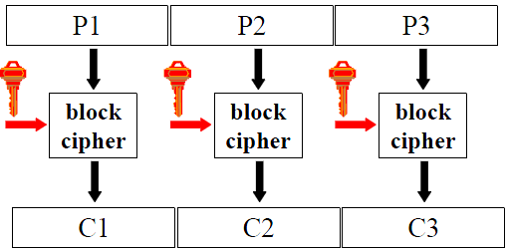
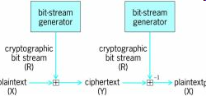
Stream vs. block ciphers
Stream cipher
Encrypt plaintext message one symbol (e.g., 1 bit) at a time
Block cipher
Divide plaintext into blocks (e.g., 64 bits), treats block as a unit to process

Slide 34
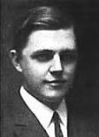
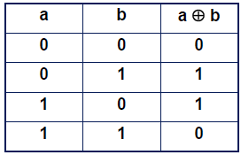
One-time-pad: stream cipher
plaintext M
⊕
cipertext C
⊕
plaintext M
K
K
Created by Gilbert Vernam 1917
1890-1960: US engineer, inventor of XOR
M, C, K: same length
Encryption: C = M ⊕ K
Decryption: M’ = C ⊕ K = M ⊕ K ⊕ K = M
Extended Vigenere cipher
☺ the only algorithm theoretically sure, if:
K is perfectly random
K is used only once:
if K is reused ?
☺ C contains no information about M
☹ generation and transportation of K
Notes:
一战
苏联间谍1942-48
美苏热线

Slide 35
One-time-pad
Teletypewriter used in US/Soviet Union hotline kept at US National Cryptological Museum

Slide 36
Names connected with OTP
Co-inventors of OTP
Joseph Mauborgne (1881-1971) became a Major General in US Army
Gilbert Sandford Vernam (1890 -1960) was AT&T Bell Labs engineer
Security of OTP
Claude Elwood Shannon (1916 -2001), American mathematician and electronic engineer, father of information theory
Notes:
香浓，人工智能，对弈软件

Slide 37
One-time-pad: test
Alice wants to send a message M to Bob
Difficult to agree/exchange the secret key K
They think of the protocole below
Alice picks a random number K₁ and sends S₁ = M ⊕ K₁ to Bob
Bob picks a random number K₂ and sends S₂ = S₁ ⊕ K₂ to Alice
Alice sends S₃ = S₂ ⊕ K₁ to Bob
Bob obtains M : M = S₃ ⊕ K₂
Is it secure? If not, give an attack

Slide 38
One-time-pad: random numbers
Keys need to be random
Random number generation is challenging
External randomness: noise
Pseudo-random generators
John vonNeumann
Anyone who considers arithmetical methods of producing random digits is, of course, in a state of sin.

Slide 39
OTP: proof of security (secrecy)
OTP is the only secure protocol proved so far
What is security (secrecy), formally?
Intuition: attacker cannot obtain any information about M
Perfect secrecy
A system is perfectly secret if for any m, c
Pr(M=m) = Pr(M=m|C=c)
OTP is perfectly secret
Pr(C=c|M=m) = Pr(K=m⊕c|M=m)=1/2^{l}
Pr(C=c|M=m)*Pr(M=m) = Pr(M=m|C=c)*Pr(C=c)

Slide 40
DES: Data Encryption Standard
Developed by IBM influenced by National Security Agency
Standardized in 1977
Block size: 64 bits
Key size: 56 bits
One of the most popular block cipher
The best studied symmetric algorithm
Nowadays considered insecure due to key length
But: 3DES yields very secure cipher, still widely used today
Replaced by the Advanced Encryption Standard (AES) in 2000

Slide 41
Design criteria
High level of security
Security must reside in key, not algorithm
Not patented
Efficient to implement in hardware
Slow to execute in software

Slide 43
Design rationale Confusion & Diffusion
Claude Shannon:
There are two primitives with which strong encryption algorithms can be built: Confusion and Diffusion
Confusion
Make relationship between (plaintext, key) and ciphertext output as complex (non-linear) as possible
Acheived by substitution
Diffusion:
Spread influence of each input bit across many output bits
Acheived by permutation
Confusion or diffusion along is not enough
Concatenate confusion and diffusion
Product ciphers

Slide 44
Product ciphers
Most of today's block ciphers are product ciphers
Consist of rounds
Changing 1 bit in plaintext results on average changing half of bits in ciphertext

Slide 45
DES algorithm overview
Block size: 64 bits
Key size: 56 bits
Symmetric cipher:
Same key for encryption/decryption
16 rounds
each performing identical operation
Different sub-key in each round
derived from main key

Slide 46
Initial and Final Permutation
Bitwise Permutations.
Inverse operations.
Described by tables IP and IP⁻¹
No security value: hardware consideration
Notes:
历史原因：为了连线方便

Slide 47
Feistel Network
An important template for block ciphers
Can be used for both encryption and decryption
Just inverse arrows
Notes:
DES用了Feistel

Slide 48
Feistel Network
L and R swapped again at the end of the cipher

Slide 49
The Scrambling function f
Key component of DES
4 Steps:
Expansion E
XOR with round key
S-box substitution
Permutation P

Slide 50
The Expansion Function E
Main purpose: increases diffusion

Slide 51
XOR with Round Key

Slide 52
The S-Box
8 substitution tables.
6 bits of input, 4 bits of output.
Non-linear and resistant to differential cryptanalysis
Crucial element for DES security!
The only non-linear part of DES
Notes:
Each row in the S-Box table should be a permutation of the possible output values
S-box设计准则：非线性，每位均影响输出，每行遍历所有数字
P设计准则：确保影响下一轮

Slide 53
The permutation P
Bitwise permutation
Introduces diffusion
Output of 1 S-Box affect several S-Boxes in next round
Diffusion by E, S-Boxes and P guarantees that
after Round 5 every bit is a function of each key bit and plaintext bit.

Slide 54
Sub-key generation
16 round keys (subkeys) k_{i}
48 bits each
derived from original 56-bit key
Input key size of the DES is 64 bit
56 bit key + 8 bit parity
Parity bits removed in permutation PC-1

Slide 55
Sub-key generation
Split key into 28-bit C₀ and D₀
Rounds i=1, 2, 9 ,16,
C_{i} and D_{i} rotated left by 1 bit
Other rounds
rotated left by 2 bits
all together 28 bits
C₁₆=C₀ and D₁₆=D₀
Round key K_{i}
permuted subset of C_{i} and D_{i}

Slide 56
Decryption
Feistel ciphers
only keyschedule is modified for decryption
Generate same round keys in reverse order

Slide 57
Implementation
Operations
Permutation
Swapping
Substitution (S-box, table lookup)
Bit discard
Bit replication
Circular shift
XOR
Hard to implement?
Hardware: easy
Software: hard

Slide 58
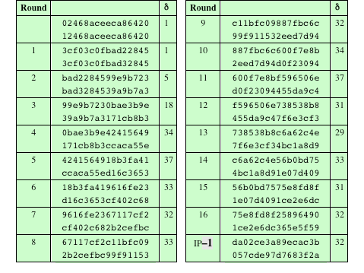
Avalanche Effect
DES has a strong avalanche effect
Small change in plaintext/key leads to big change in ciphertext

Slide 59
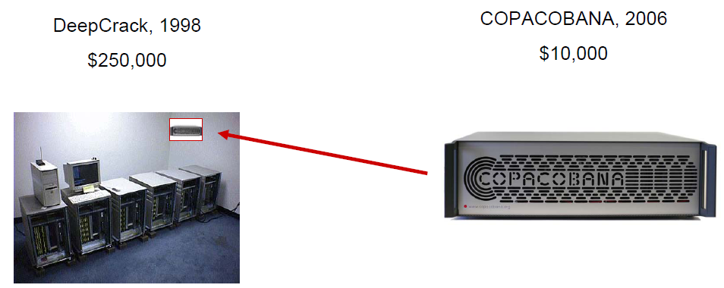
DES attacks
2 criticisms
Key space too small: 56 bits
S-box design criteria kept secret
Are there any hidden attack/backdoor, only known to NSA?
So far there is no known analytical attack in realistic scenarios
1998: DeepCrack: 50h, 250k$
2006: COPACOBANA (Cost-Optimized Parallel COde Breaker): 6.4 days, 10k$

Slide 60
2 DES
P
^{E}K1
^{E}K2
C
Key length: 56 x 2 = 112 bits
Does 2DES “double” security? No!
Meet-in-the-Middle Attack: suppose attacker disposes (P, C)
Encrypt P with all 2⁵⁶ possible keys for K1
Decrypt C with all 2⁵⁶ possible keys for K2
Until E_{K1’}(P) = D_{K2’}(C)
Complexity: O(2⁵⁶)
Mathematically, DES is not a group
Ceasar cipher is a group

Slide 61
3 DES
3 DES is used in practice
Effective key length 112 bits
Adequate for now
Reconsider MITM attack
If k₁= k₂, then becomes DES
Backward compatible
If k₁= k₃, then becomes 3 DES with 2 keys

Slide 62
The “key” problems: weak keys
Below are keys which, after the first key permutation, are:
28 0’s followed by 28 0’s
28 1’s followed by 28 1’s
28 0’s followed by 28 1’s
28 1’s followed by 28 0’s
Why they are weak
Easy clue for brute force attacks.
Sixteen identical subkeys.
Encrypting twice produces the original plaintext
Weak keys
Alternating ones + zeros: 0x0101010101010101
Alternating 'F' + 'E': 0xFEFEFEFEFEFEFEFE
0xE0E0E0E0F1F1F1F1
0x1F1F1F1F0E0E0E0E

Slide 63
Semi-weak keys
Below are keys which, after the first key permutation, are:
1. 28 0’s followed by alternating 0’s and 1’s
2. 28 0’s followed by alternating 1’s and 0’s
…
12. Alternating 1’s and 0’s followed by alternating 1’s and 0’s
Why they are weak
For a semi-weak key pair (K₁, K₂), K₁(K₂(m)) = m
Semi-weak keys
0x011F011F010E010E and 0x1F011F010E010E01
0x01E001E001F101F1 and 0xE001E001F101F101
0x01FE01FE01FE01FE and 0xFE01FE01FE01FE01
0x1FE01FE00EF10EF1 and 0xE01FE01FF10EF10E
0x1FFE1FFE0EFE0EFE and 0xFE1FFE1FFE0EFE0E
0xE0FEE0FEF1FEF1FE and 0xFEE0FEE0FEF1FEF1

Slide 64
Test
How to distinguish a 2-round Feistel system with a random number generator?
Prove
Break a 1-round Feistel system, 2-round, 3-round.

Slide 65
Break 1-round Feistel system

Slide 66
Break 1-round Feistel system

Slide 67
Break 2-round Feistel system

Slide 68
Break 3-round Feistel system

Slide 69
Break 3-round Feistel system

Slide 70
Advanced Encryption Standard (AES)
Objective: replace DES
DES key size and block size too small
Can use Triple-DES, but slow
US NIST issued call for ciphers in 1997
15 candidates accepted in 1998
5 shortlisted in 1999
Rijndael selected in 2000
Standard in 2001

Slide 71
AES Requirements
Symmetric key block cipher
Block size: 128 bits
Key length: 128/192/256 bits
Stronger & faster than 3 DES
Active life of 20-30 years
Provide full specification & design details
Both C & Java implementations
NIST have released all submissions & unclassified analyses

Slide 72
AES Evaluation Criteria
Initial criteria:
Security: randomness, soundness, effort for practical cryptanalysis
Cost: computational efficiency, no licensing fee, small memory
Algorithm & implementation: flexibility, implementable in both software and hardware, simplicity
Final criteria
General security: NIST relies on cryptanalysis by cryptologues
Ease of software & hardware implementation
Flexibility: encryption, decryption, keying
Implementation attacks
Timing attacks: an algorithm takes different time on different inputs
Power analysis: power consumed depends on instructions
multiplication > addition, writing 1 > 0

Slide 73
Shortlisted algorithms
MARS (IBM) - complex, fast, high security margin
RC6 (USA) - very simple, very fast, low security margin
Rijndael (Belgium) - clean, fast, good security margin
Serpent (Euro) - slow, clean, very high security margin
Twofish (USA) - complex, very fast, high security margin
Contrast between algorithms with
Few complex rounds vs. many simple rounds
Refined existing ciphers vs. new proposals

Slide 74
The winner: Rijndael
Designed by Rijmen-Daemen in Belgium
An iterative rather than Feistel Cipher
Processes data as block of 4 columns of 4 bytes
Designed to be:
Resistant against known attacks
Speed and code compactness on many CPUs
Design simplicity
Some similarities to DES
rounds, round keys, alternate permutation+substitution
but not a Feistel cipher
Block size 128 bits
Key sizes 128, 192, or 256

Slide 75
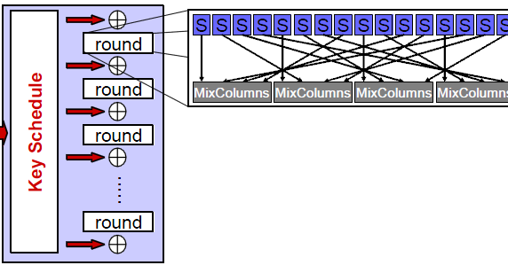
AES structure
No known successful attacks on full AES
Best attacks work on 7-9 rounds
For brute force attack, AES-128 needs much more effort than DES

Slide 76
Twofish: AES third place
Feistel
S-boxes depend on key
Slower than AES

Slide 77
Serpent: AES second place
Constructed for security
not speed
Feistel system, 32 rounds
Four-bit S-boxes
A_{i}=S(K_{i}⊕P_{i})
Adapted for parallel calculation
Same speed as DES, 1/3 of AES

